Slide 1
Zarticon 2023
Takeaways

Slide 2
You are needed
Data literacy is a superpower, and it’s one that our industry needs right now.

Slide 3
Industry-Wide Data and Insights Education Helps the Tourism Cause
We’ve never had better access to data. In today’s landscape, we must use that data to articulate community values, understand the words that resonate, and measure how well we do what we do.
This matters. Travel is essential to our economy, indispensable to our communities, and irreplaceable as an industry.

Slide 4
Data heroes can bring us into the future
The vision of tourism as a force for good is collectively pulling us into the future.
You are the linchpin to helping us get there!

Slide 5
Tourism Exists
to Improve
Resident
Quality of Life
Notes:
If we boil it down, DMO’s exist to improve the resident quality of life in our communities.

Slide 6
Smart Destinations
If destination leaders understand that the visitor economy serves to benefit the resident, and they begin considering yield management over volume, then a handful of focused actions can have immense positive impact on their communities.

Slide 8
TWO MINDSET SHIFTS
Visitor economy serves to benefit resident quality of life
Yield-management over volume

Slide 9
FIVE KEY ACTIONS
Precision Demand Generation
High-quality Visitor Experience
Year-round, Level-loaded Visitation
Contribute To Vibrant Communities & Strong Local Economies
Report Resident-focused Outcomes

Slide 10
The Use of AI
”People don’t always want to adopt new technology because they’re too busy doing what they’ve always done.”
— Dave Carruthers
Whether we’re ready or not, generative AI tools like ChatGPT and the apps that use it are already creating massive disruptions, and they have awesome potential for destinations, too.

Slide 13
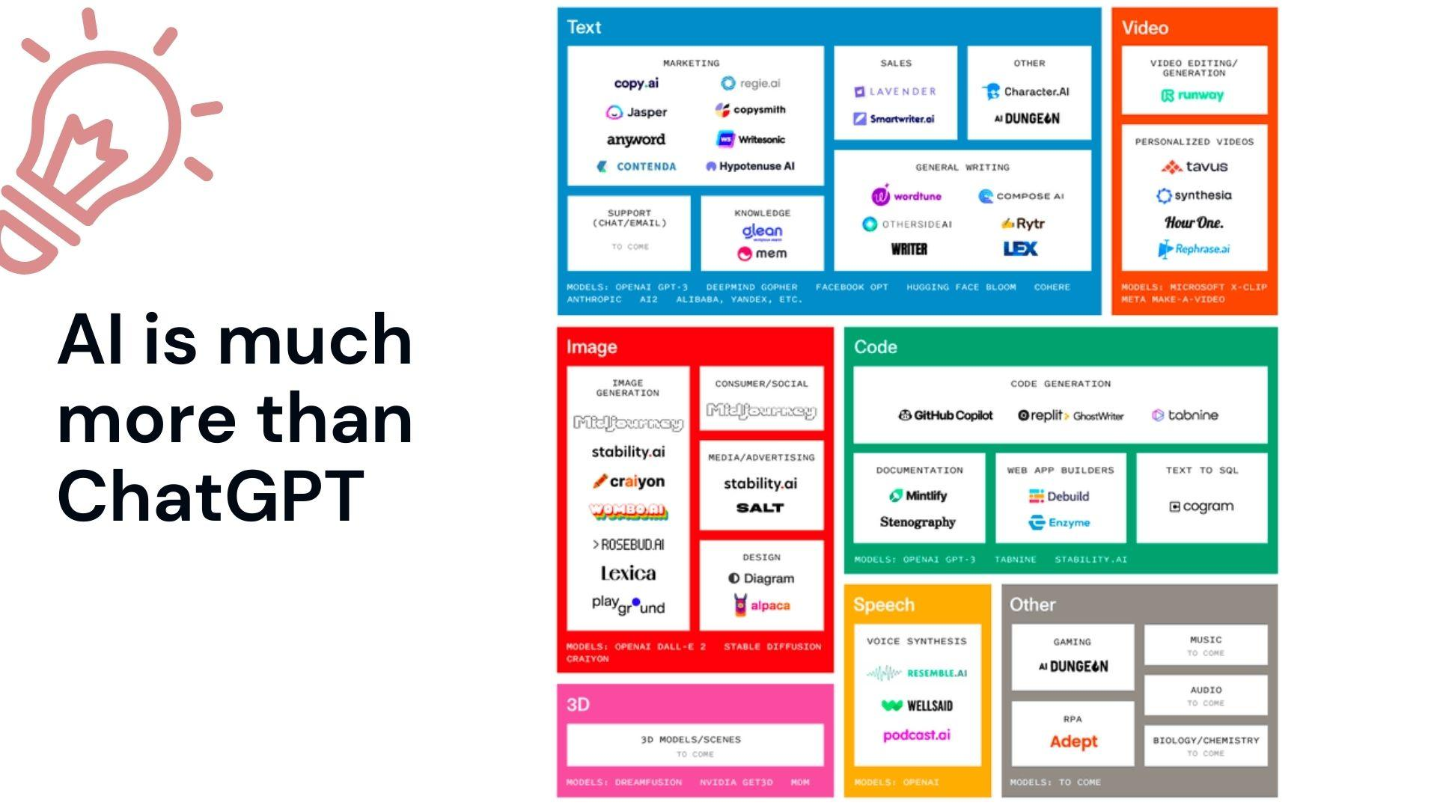

Slide 14
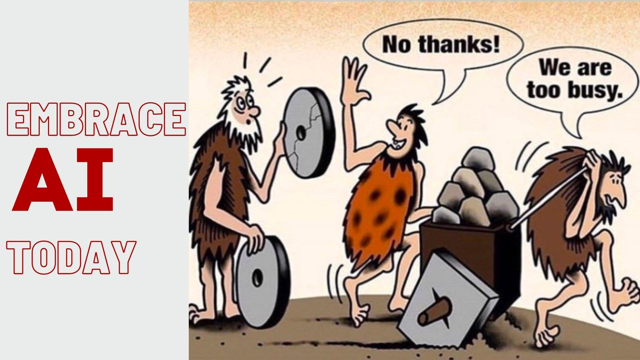

Slide 15
What is Data?
Data is information that's been collected and organized.

Slide 16
What is Data Literacy?
Data literacy is the ability to
understand & communicate data.
Notes:
Just like a kid developing literacy skills would learn to understand and communicate words, data literacy means learning how to understand and communicate data.

Slide 17
ABCs
of Data Literacy
Always start with strategy.
Big data makes analysis special.
Charts are meant to help.
Draw meaningful conclusions.
Expect data limitations.
Find the trends and patterns.

Slide 18
Always Start with Strategy
Focused Mindset Focused Outcomes
Begin with the end in mind
Know what questions your data can answer

Slide 19
Big Data Makes Analysis Special
What is Big Data?
Large amounts of data
Collected passively from digital interactions
With great variety and a high rate of velocity

Slide 20
Charts are Meant to Help
Charts are meant to help you understand data
Know the different types of charts and why they are used

Slide 21
Draw Meaningful Conclusions
When looking at data you can find three things:
Answers, Mysteries, and Insights
Don’t jump to conclusions –
Understand correlation vs. causation

Slide 22
Expect Data Limitations
Your data isn’t like a crystal ball –
more like camera angles filming a sports match
Adjust your expectations and
know the limits of your data

Slide 23
Find the Trends and Patterns
It’s not what you see, but the relationship between them that is the most meaningful.

Slide 24
Surveys vs. Geolocation Data
Advocates for geolocation data and surveys don’t always see eye to eye, but through triangulating old and new data sets and evolving new KPIs, the industry can draw on the strengths of both.

Slide 25
Place-
Based Strategy
Everything in tourism happens in or about a place. Zartico’s place-based strategy allows different places and data sets to work together to help destinations market more strategically and manage more effectively.

Slide 26
Place-Based Strategy Consists of
Boundary
Geolocation, Credit Card, Events
Regions
Geolocation, Events
Categories
Geolocation, Credit Card, Website, Content, Website Contribution
POIs
Primary = Reason people visit your destination
Contextual = Representative sample of where visitors spend time & money

Slide 27
Understand Spending & Movement
Geolocation
Accommodations
Attractions
Business & Professional
Commercial
Food
Gas & Service Stations
Health
Nightlife
Retail
Transportation
Outdoor Recreation
Credit Card
Accommodations
Attractions
Business & Professional
Commercial
Food
Gas & Service Stations
Health
Nightlife
Retail
Transportation

Slide 28
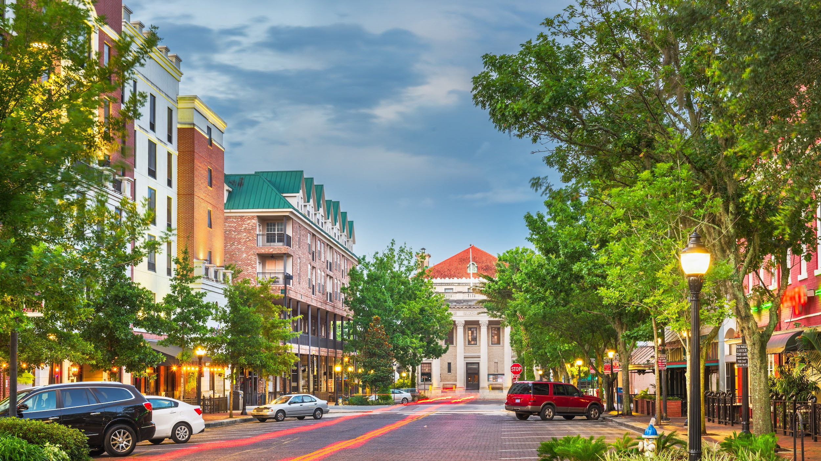
Market more strategically:
Identifying behavioral trends
Which markets stay in overnight accommodations
What itineraries are often combined together.
Manage more effectively:
Utilization of public lands
Impact of events
Visitor distribution
Quality of visit

Slide 29
Data Communication & Storytelling Using ZDOS Data

Slide 30
v
v
Approach the data with a plan
Source the relevant data
Analyze the data
Share your findings

Slide 31
I want to understand
what my visitors spent the most on during their trip
Part B: What information could help you?
share information to add value to this week’s planning meeting
so that I can
Part A: What’s a situation in your destination where information could help?

Slide 32
Use Your Deck For Sharing

Slide 33
Near
(Geolocation Data)
Near acquires “human movement data” from 200,000 thoroughly vetted mobile apps and prioritizes privacy and data quality. You can think of geolocation data like a raw ingredient (a potato, perhaps) — what makes the data distinct and useful is the way that companies like Zartico prepare and package the data before delivering it to the destination.

Slide 34
PredictHQ
(Event Data)
PredictHQ receives event data from 350+ different sources, including direct submissions from partners. Stay tuned for new forms in the ZDOS™ and new event types, like youth sports.

Slide 35
Affinity
(Spend Data)
Affinity sees about 7% of credit and debit card transactions, representing an accurate, third-party validated reflection of consumer spend behavior in the United States

Slide 41
Your industry needs you as a data hero, the most powerful person in the room.
You can deftly wield your data to assist you in whatever situations you face.
Using data is best done with narrative to capture attention and achieve your goals.

