Slide 1
Topic
Your Destination Name
Date

Slide 2
KEY ANSWER:
Keep to 1-3 sentences, bold only the important words if needed.

Slide 3
KEY QUESTION:
(insert question here - what is it you want to understand?)
in (insert name of your destination)?
Insert a relevant image
(choose from the ones at the end of this deck or find your own)
Optional:
Date(s): Insert Dates

Slide 4
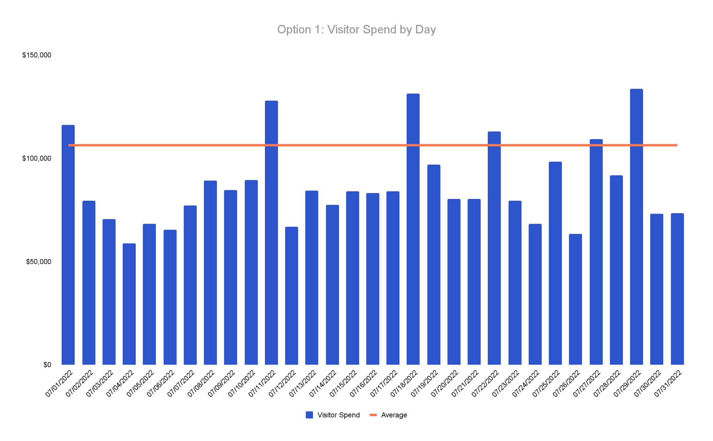
IN DATA:
Explain How Data Supports Your Answer
Add a headline to your chart that explains what your chart shows
PLACE CHART HERE
Source: Geolocation (Near), Spend (Affinity) (DATES, ANYTHING ELSE)

Slide 5
INSTRUCTIONS:
PAUSE HERE UNTIL BREAKOUT 2
You will be guided through filling out the next part soon!

Slide 6
FURTHER
CONTEXT
Keep to 1-3 sentences, bold only the important words if needed. Keep font between 14-18.
Keep to 1-3 sentences, bold only the important words if needed. Keep font between 14-18.
Keep to 1-3 sentences, bold only the important words if needed. Keep font between 14-18.

Slide 7
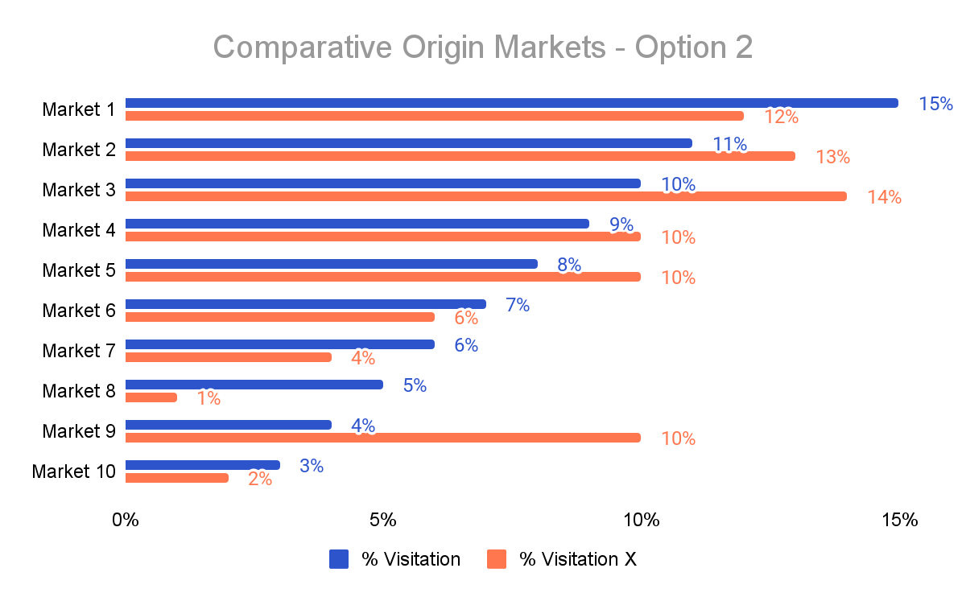
IN DATA:
Explain How Data Supports Your Answer
Call out information here: if there is no callout, delete and move graph up
PLACE CHART HERE
Source: Geolocation (Near), Spend (Affinity) (DATES, ANYTHING ELSE)

Slide 8
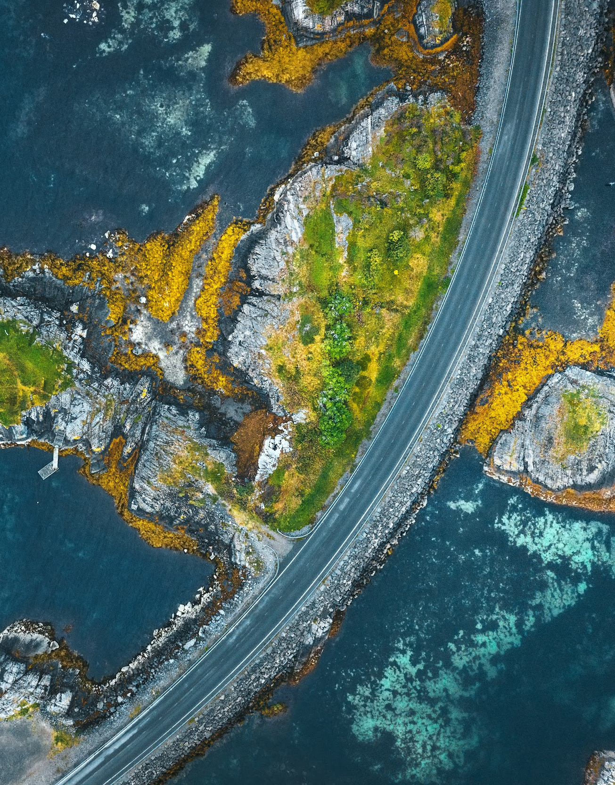
IN NUMBERS: Explain The Numbers That Support Your Answer Here
% Data
Compared to overall %
% Data
Compared to overall %
% Data
Compared to overall %
Source: Near, Affinity (DATES, ANYTHING ELSE)
Notes:
OPTIONAL SLIDE

Slide 9
POTENTIAL VISITOR PROFILE
BASED ON TRENDS
From: (put your top DMA here)
Age Range: (put your top age range here)
Income Level: (put your top income level here)
Where They Visited: (put top region here)
What They Spent Money On: (put top spend category here)
Fictitious Name More Information

Slide 10
QUESTION:
IMAGE CREDIT: DISCOVER LONG ISLAND
Restate your question using bold for important words?
Insert a relevant image
ANSWER:
Restate your answer using bold for important words.
YOUR DESTINATION LOGO HERE

Slide 11
SUGGESTED NEXT STEPS:
Keep to 1-3 sentences, bold only the important words if needed.
ONLY USE THIS SLIDE IF THERE IS ANY ACTION YOU RECOMMEND.

Slide 12
THANK YOU!
Your Name
Your Title

Slide 13
INSTRUCTIONS:
ZARTICO RESOURCES
Add these as needed.

Slide 14
Need to know how to take a screenshot?
Click here for instructions for a Mac
Click here for instructions for a PC

Slide 15
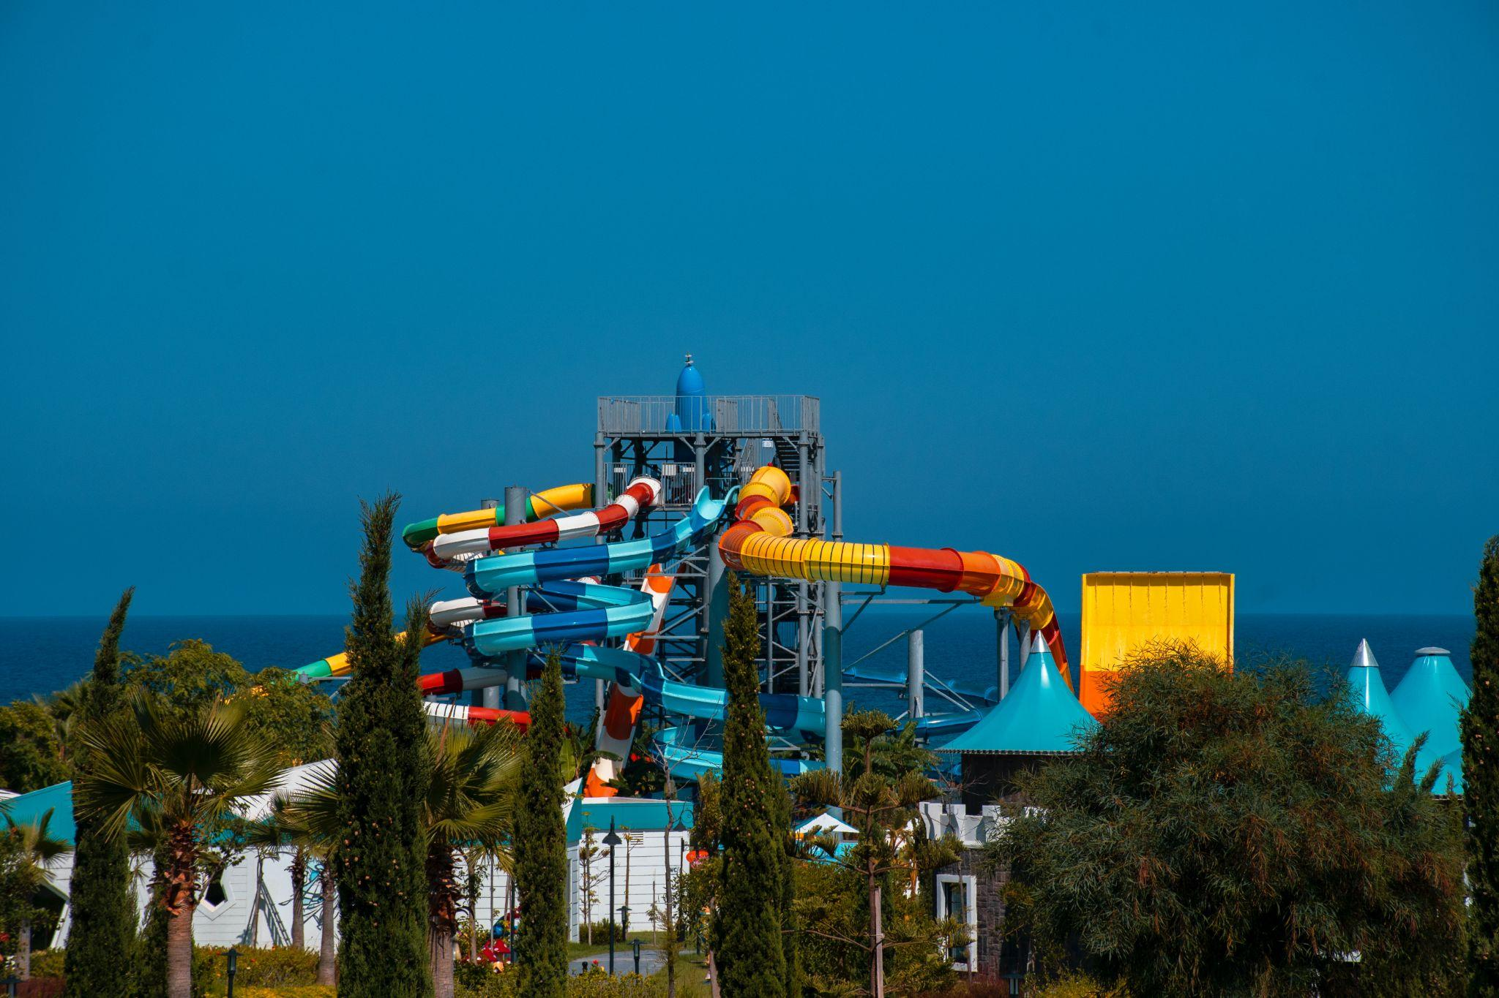
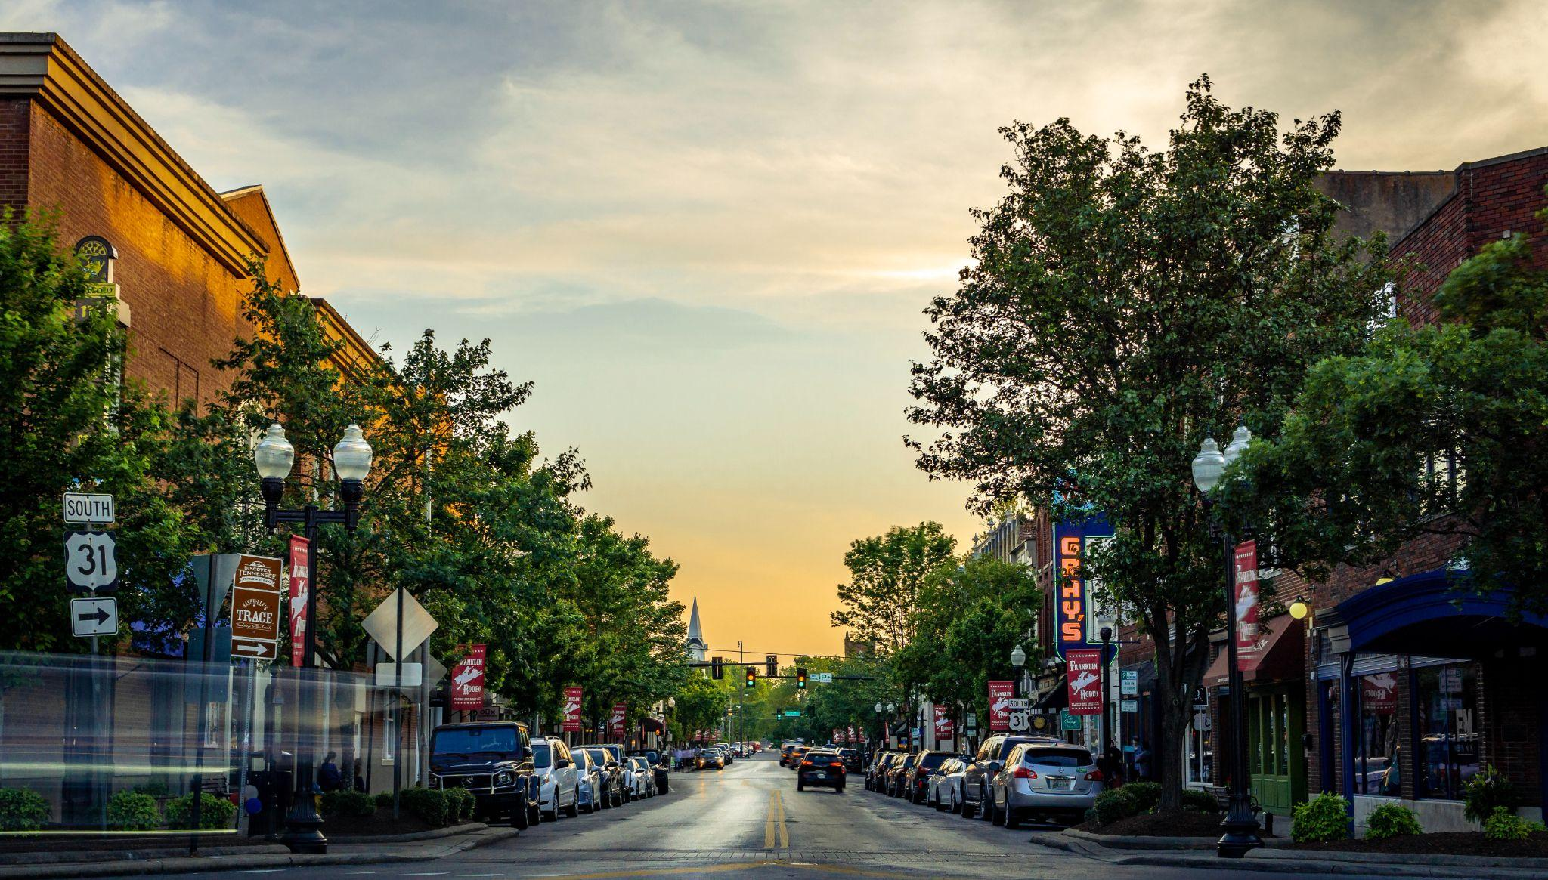
Need a photo to add to your deck?
Copy and paste from the images below.

Slide 16
Use These Extra Slides For Context

Slide 17
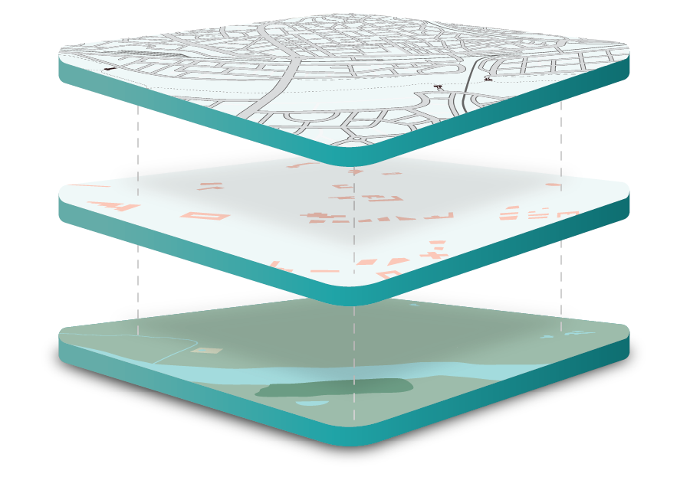
ZARTICO’S LICENSED DATA SETS
Geolocation
Largest Commercially Available Geolocation Data Set
Daily Visibility Of Both Visitors & Residents
1.6 Billion Global Devices in 180+ Countries
Historical Data From January 1, 2021
Spend Data
90 Million Cards
10 Billion Transactions Annually
4 Brands Credit & Debit Cards
Historical Data From January 1, 2021
Event Data
300+ Global Event Sources
40+ Million Events Worldwide
12 Month Look Into the Future
Historical Data From January 1, 2021
Notes:
Transition – These three high frequency, high resolution data sets, connect with Your Data and public data to form the Integrated Data Model.

Slide 18
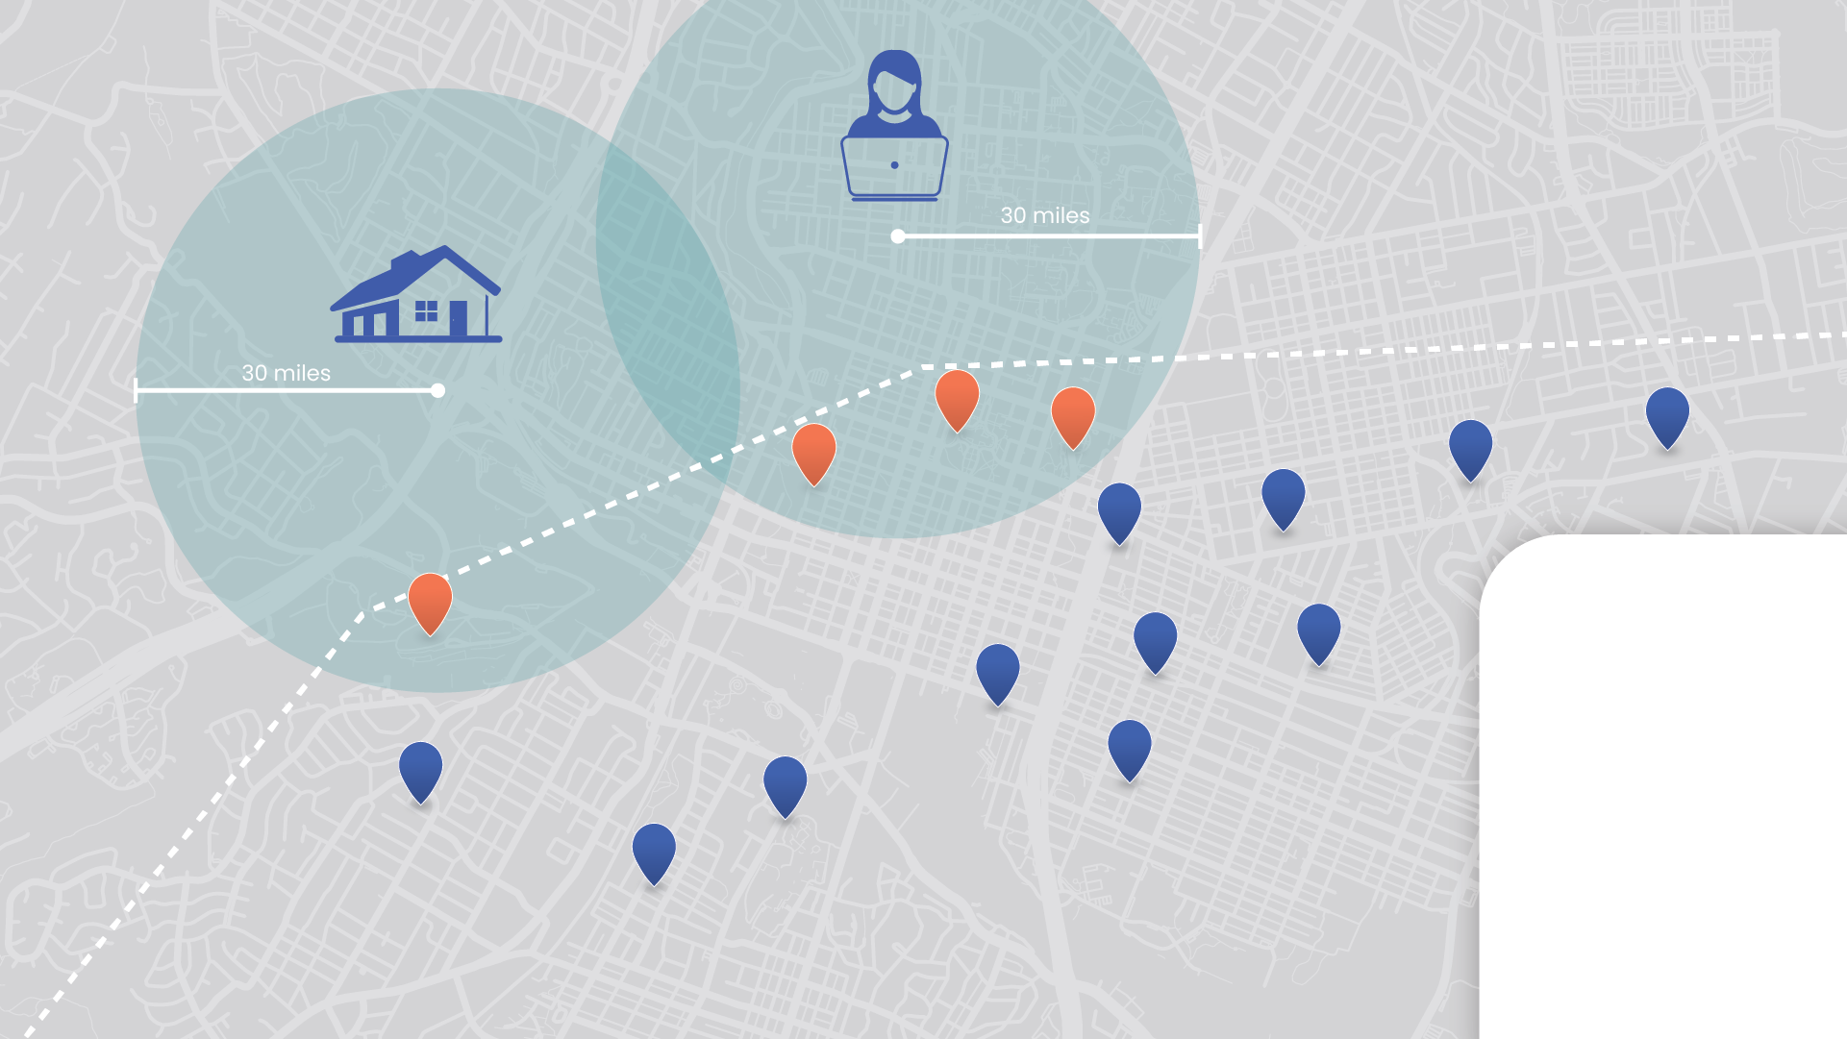
Visitor In Location Data
Visitor:
Total number of device count observed more than 30 miles from the common device location to the POI.
Your destination’s boundary
Resident:
Total number of device count observed less than 30 miles from the common device location to the POI.
= Observed as visitor
= Observed as resident

Slide 19
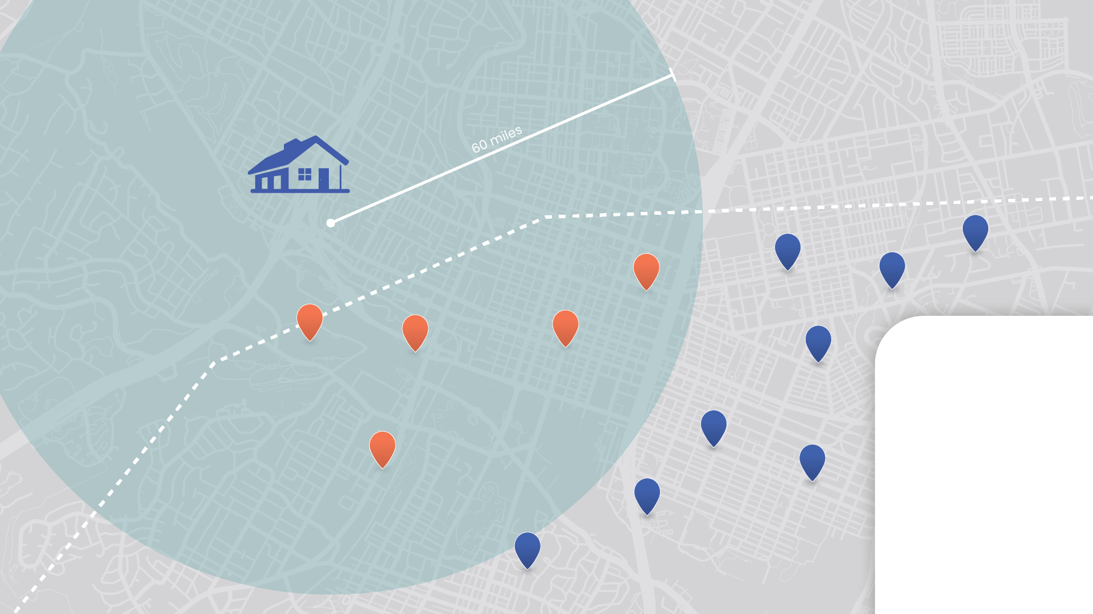
Visitor In Spending Data
Visitor:
Total number of credit card count observed more than 60 miles from the zip code location to the POI.
Your destination’s boundary
Resident:
Total number of credit card count observed less than 60 miles from the zip code location to the POI.
= Observed as visitor
= Observed as resident

